Slide 1
Amazone Sales Report
Analysis
Charts & Insights

Slide 2
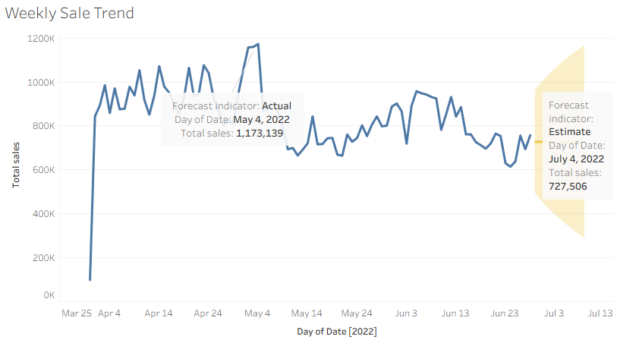
The chart shows weekly total sales from late March to early July 2022.
A forecast is also included for the early July period.
Highest weekly sales occurred around May 4, 2022, with 1,173,139 units sold.
This peak suggests a sales spike, possibly due to a promotion, festive season, or new launch.
After May 4, there is a noticeable drop in weekly sales
This may indicate seasonal decline, diminished consumer interest, or stock issues.
The trendline shows frequent fluctuations, indicating weekly demand variability
For July 4, 2022, forecasted weekly sales are 727,506.
The forecast indicates a modest recovery from recent lows but not close to early peak levels.

Slide 3
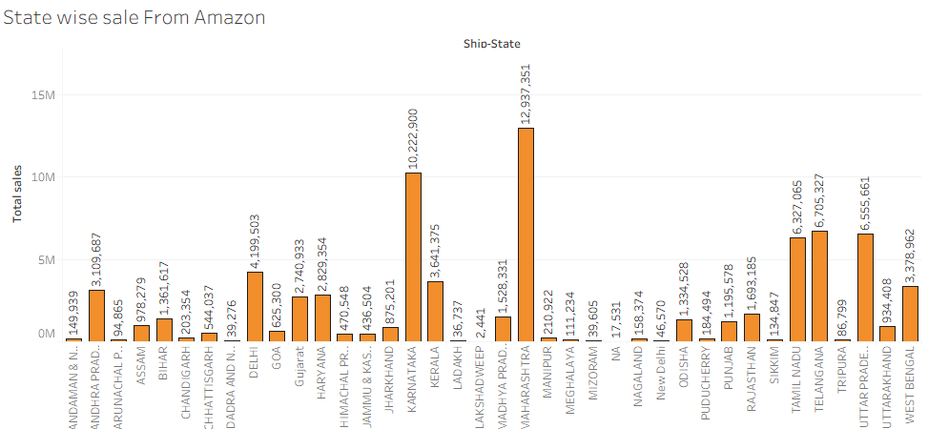
The chart is showing uneven distribution of sales across different states.
Maharashtra, Karnataka & Tamil Nadu hits high may be the reason behind is Large urban populations, Higher internet & smartphone penetration & Better logistics & fulfillment networks
Whereas Lakshadweep, Ladakh & Mizoram recorded low sale. likely due to Limited delivery reach, Sparse population, Weaker e-commerce adoption
Sales distribution is heavily skewed — a few large states (MH, KA, TN) dominate.
Northeast and Union Territories mostly underperform, possibly due to infrastructure and access challenges.
States like UP and WB, despite being large, show lower-than-expected sales compared to MH or KA — indicating untapped potential

Slide 4
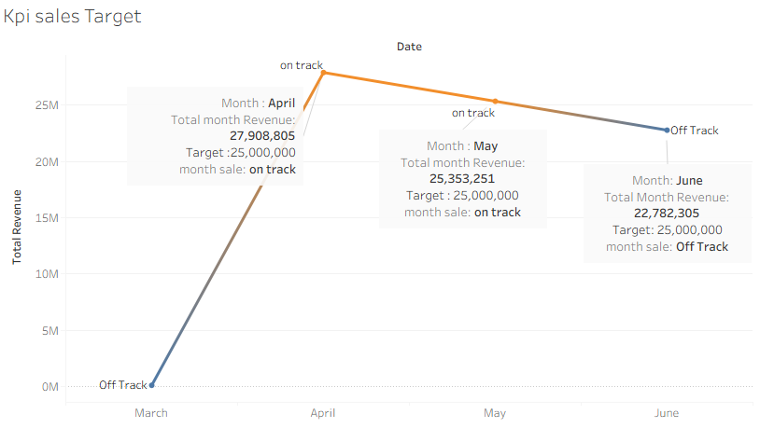
Strong upward jump from March → April, surpassing the target.
Gradual decline from April → June, with June falling below target.
Performance volatility suggests potential seasonal or demand fluctuation.
Business Implications
April & May achieved sales goals, but May was only marginally above target — risk of slipping below without proactive actions.
June’s drop signals a need to identify causes (seasonality, promotions ending, supply chain issues, etc.) and implement recovery strategies.

Slide 5
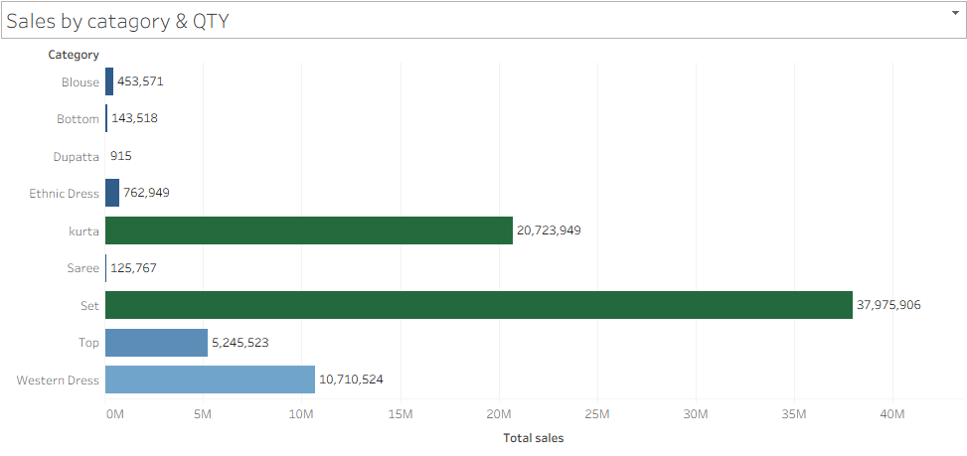
Full Outfits (Set, Kurta, Western Dress) dominate — suggesting customer preference for ready-to-wear complete clothing over individual items.
Traditional categories like Saree, Blouse, and Dupatta are underperforming, indicating a possible shift in consumer behavior or lack of modern styling options in those segments.
Business Recommendations:
Double down on Set and Kurta categories through targeted campaigns and inventory expansion.
Explore bundling opportunities for low-volume categories like Dupatta with better-selling ethnic wear.

Slide 6
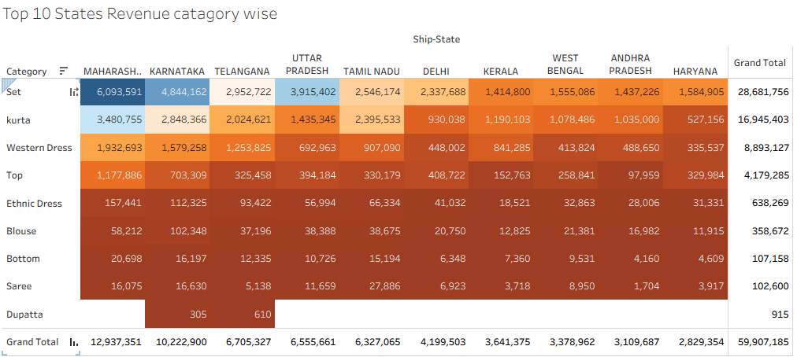
*As highlighted Highest Revenue Generating States are Maharashtra, Karnataka & Telangana These three states contribute more than 50% of total revenue (~₹59.9M).
*Top Performing Categories are Set, Kurta & Western dress These three categories alone contribute >90% of the total sales.
Chart is strongly depicting that which category is best performing in which state
Focus marketing and inventory on Sets and Kurtas, especially in Maharashtra, Karnataka, and Telangana.
Improve presence in low-performing states like Haryana, WB, and Kerala with localized offers.
Discontinue or reposition very low-performing categories like Dupatta.

Slide 7
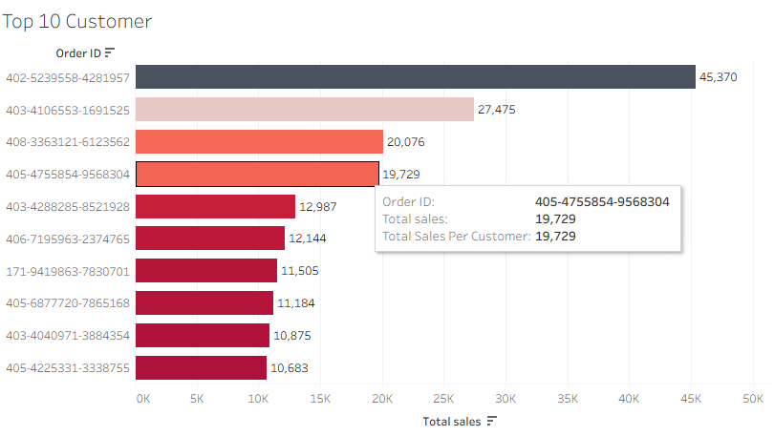
*“Order ID: 402-5239558-4281957” is the Highest spender — contributes significantly more than others, indicating a high-value customer.
*Sales drop from top to bottom is steep:
Top customer: ₹45K+ 10th customer: ₹10.6K this shows a significant concentration of revenue in the top few customers.
*Business Recommendations:
Reward top customers with loyalty benefits, exclusive offers, or early access to products.
Upsell to medium-tier customers to push them into higher-spending brackets.

